Slide 1
BRITISH AIRWAYS DATA ANALYSIS

Slide 2
CONTENT
Web Scraping
Data Cleaning
WordCloud of Reviews
Sentiment Analysis
Machine Learning

Slide 3
WEB SCRAPING
Data was collected from the British Airways website. Once the data was collected, it was prepared and cleaned before analysis using python and its libraries.
Modelling, sentiment analysis and wordclouds were used to provide insight into the content of the reviews

Slide 4
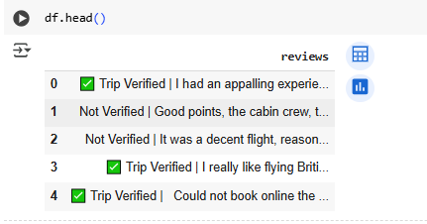
DATA CLEANING
The raw data looked like the the figure to the left. Very messy.
The step-by-step cleaning that was done included:
Removing the tick marks
Removing leading and trailing spaces

Slide 5
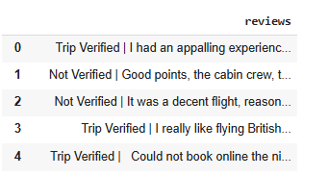
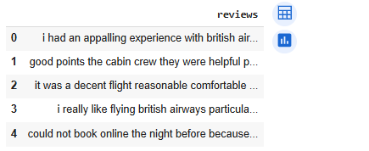
DATA CLEANING
The first set of cleaning resulted in the image to the left.
Further cleaning included:
Drop duplicate reviews.
Remove ‘Trip Verified/Trip Not Verified’.
Remove pipes and pipe spaces.
Set all texts to lowercase.
Remove Special characters.

Slide 6
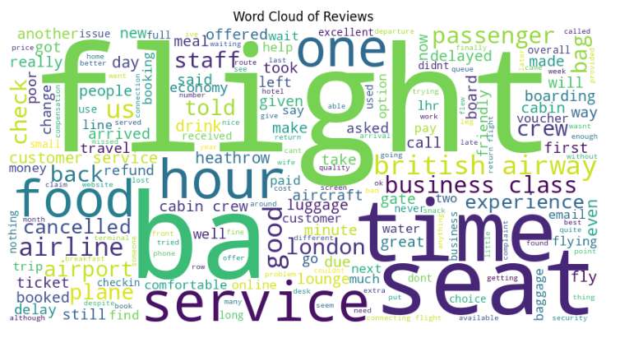
WORDCLOUD OF REVIEWS
The wordcloud highlights the most common themes mentioned by passengers in their reviews.
The larger the word appears, the more frequently it was used.
Words like "flight", "seat", "service", and "food" appear the largest, meaning these are the most discussed aspects of the passenger experience.
This tells us what customers care about most and where their expectations are set.

Slide 7

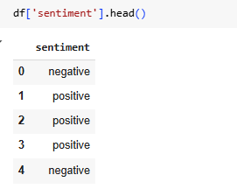
SENTIMENT ANALYSIS
The point of sentiment analysis in this project is to understand how customers feel about their experiences with British Airways, not just what they talk about (word cloud), but whether their feedback is positive, negative, or neutral.
From the analysis at the top left corner, it appears that there were more negative comments about British Airways than positive and Neutral comments.

Slide 8
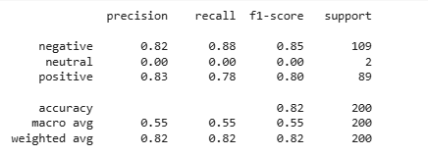
MODELING (MACHINE LEARNING)
Precision = Of all predicted X, how many were actually X
Recall = Of all actual X, how many were predicted correctly
F1-Score = Balance between precision and recall
Support = Number of actual samples for each class
Observations:
The model performs very well on negative and positive reviews (F1-scores above 0.80).
But it completely fails on neutral reviews — this is likely because there are only 2 neutral samples, not enough for the model to learn.

